Slide 1
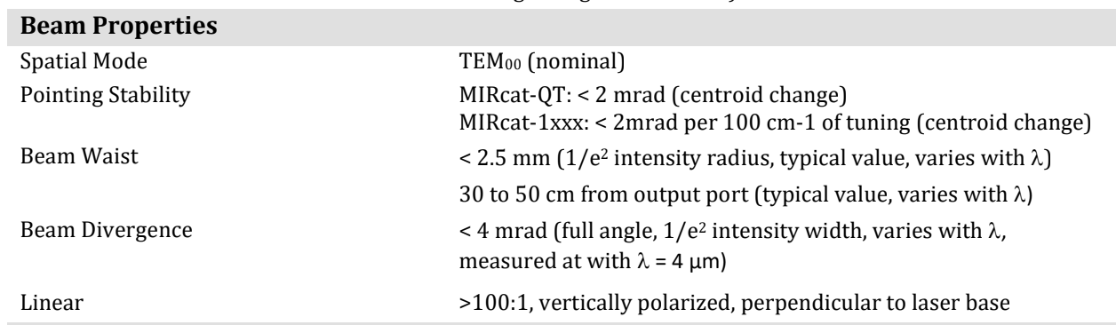
QCL
QCL output beam waist w_0=2.5 mm
Stable until 30-50 cm from the output.

Slide 2
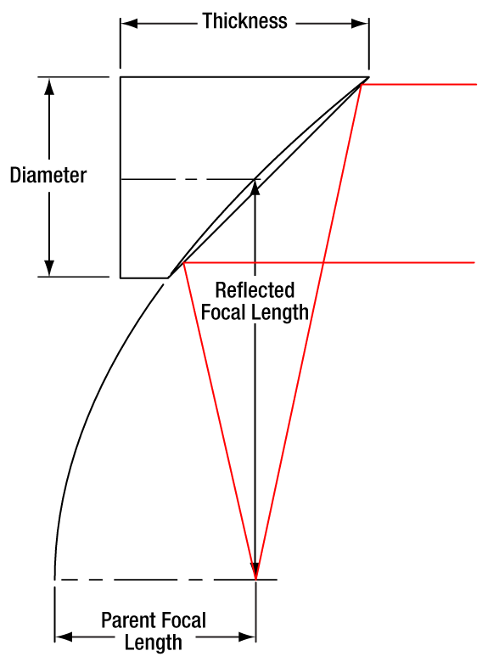
Steering
A gold coated plane mirror used to rotate the beam by 90 degrees. Two mirror system used to make the alignment easier. Gold mirror’ model to be added here.
Second mirror is gold coated off-axis parabolic mirror. It focuses the incident collimated beam while redirecting it by 90 degrees. Mirror model is MPD149-M01. Its reflective focal length is 101.6 mm (4 inches).

Slide 3
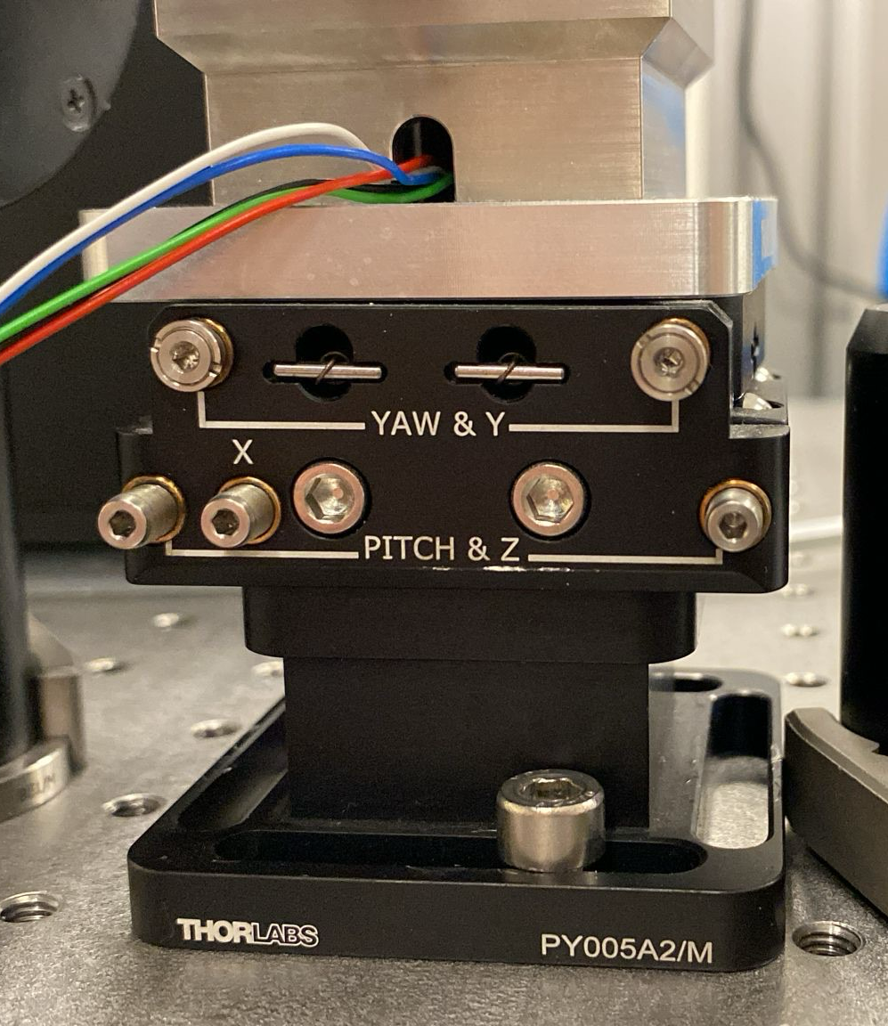
ADM
Beam diameter should be less than 1.6 mm to be able to focus the beam inside ADM. I measured distance between the prongs of the QTF as 0.8 mm, but it is not separately stated. Module connected to 5-axis translational stage PY005.

Slide 4
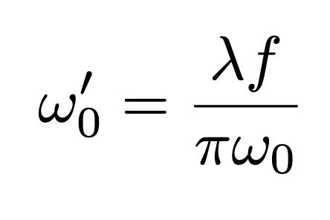
Beam diameter calculation
Gaussian collimated beam focusing formula
We have w_0=2.5 mm and wavelength of 7.7 µm. With f=101.6 mm w’_0=0.1 mm or simply 100 µm at 101.6 away from the main optical axis of the OAP. Rayleigh range z_R=4.1 mm.

Slide 5
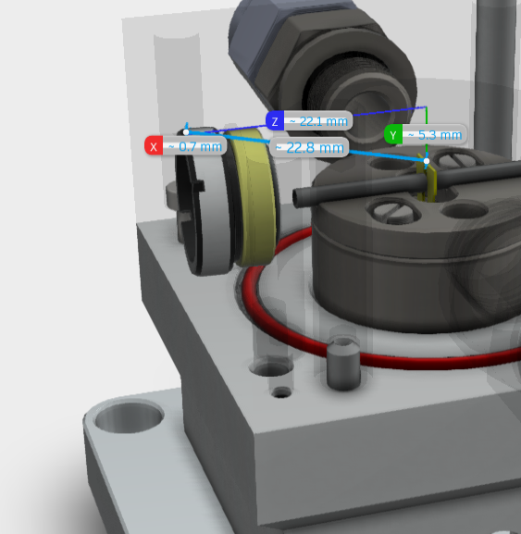
Beam waist at window
Wedged window located approximately at 22.1 mm away from the QTF. Since QTF placed at the focus, we can calculate gaussian beam waist at the window, which is w(101.6-22.1=79.5 mm)=0.55 mm, corresponds to 1.1 mm beam diameter. This value still smaller than 1.6 mm, indicated beam diameter value for the ADM.

Slide 6
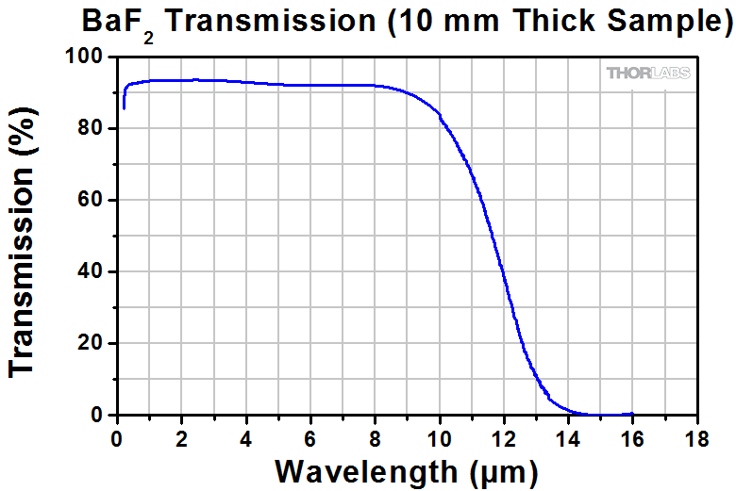
Window losses
To be sure that beam does not hit the walls or resonator tubes inside the ADM both input and output laser power should be measured and compared. Both ends have BaF2 window with thickness of approximately 2.5 mm. BaF2 transmittance values provided in the thorlabs website for each wavelength. By using Fresnel equations combined with Beer-Lambert for bulk losses, from presented values first absorbance of the BaF2 should be found. Then, for given wedge window thickness of the ADM projected loss through both windows should be included.

Slide 7
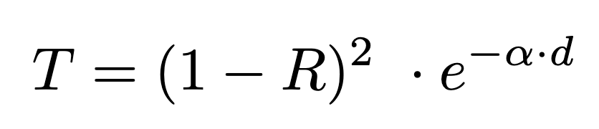
Window losses
Given T= 92% for 7.7 µm for 10 mm thick BaF2. Yields α=1.98 cm-1 for bulk absorption. By using this values, T’= 93.4% for 2.5 mm window. Since we have two windows, we need to apply this formula twice. Combined T for ADM results with T=87.2%.
T: transmittance, R: reflectance, α: absorbance, d: thickness

Slide 8
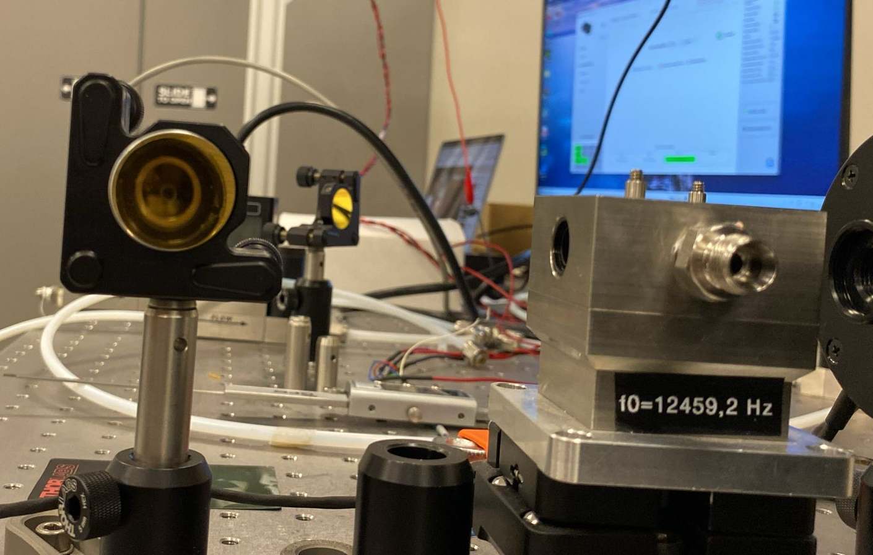
Alignment
First plane mirror aligned with the laser output to steer the beam into OAP mirror. To be able to focus properly with the OAPM, beam should be parallel to the optical axis. OAPM should be located exactly at the focus distance from the center of the ADM, which is 101.6 mm. Optical axis is at the half distance of the mirror and QTF approximately located at the middle of the ADM. These points can be marked with a pen for better alignment. After beam is incident to the optical axis, OAPM height and orientation should be set perpendicular to the ADM input window. Without using the knobs, by orienting the OAPM beam can be directed to the ADM input. After that point, OAPM should be fixed.

Slide 9
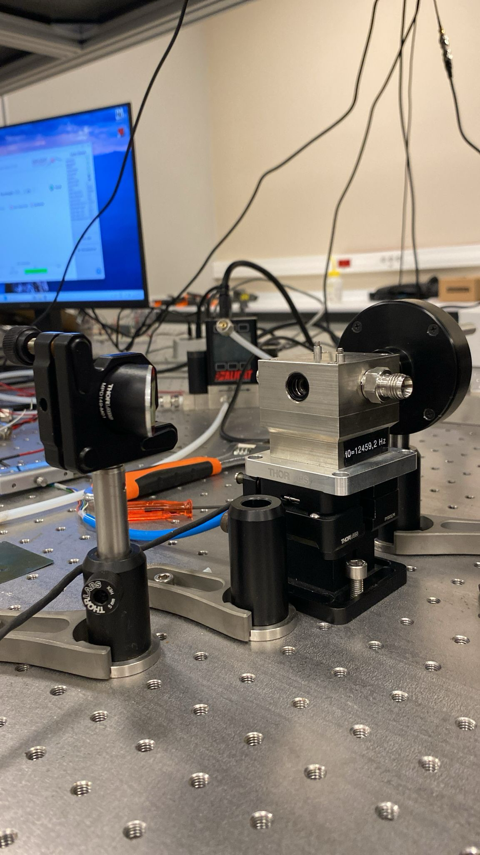
Alignment
After beam is entered to the ADM window at RFL distance, next step is to fine tune the alignment via 5 stage optical axis under the ADM. After beam have seen at the output, next step is to place a power meter on the output of the ADM to fine tune the alignment. Depending on the wavelength, input and output power should be compared by including window losses, which is 12.8% for 7.7 µm. If input and output beam close to each other after including the window losses, beam can be considered to aligned and experiment can be further conducted.

Slide 10
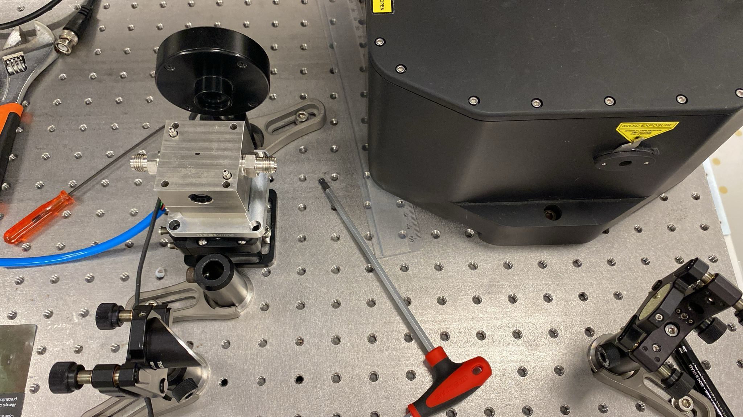
Final setup

